Slide 1
Vibhaag Web App
A college analytics, session monitoring and
management tool
By,
Sudhanva N
PES1201702260
Karthik D
PES1201702449
Harsha K Y
PES1201801839
Guide:
Dr Veena S,
Chairperson,
Department of Computer
Applications

Slide 2
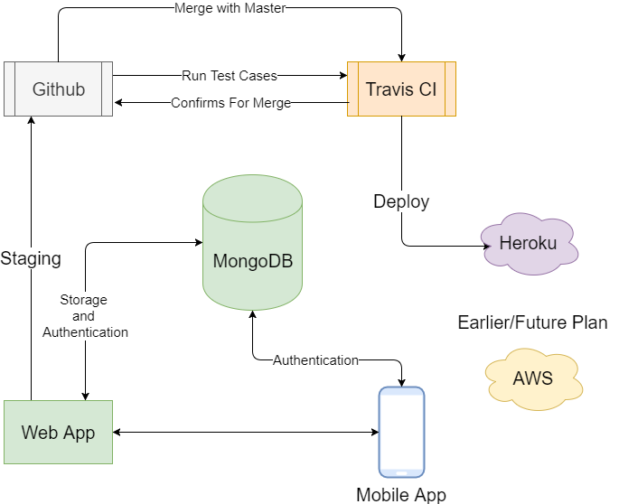
Technology Review

Slide 3
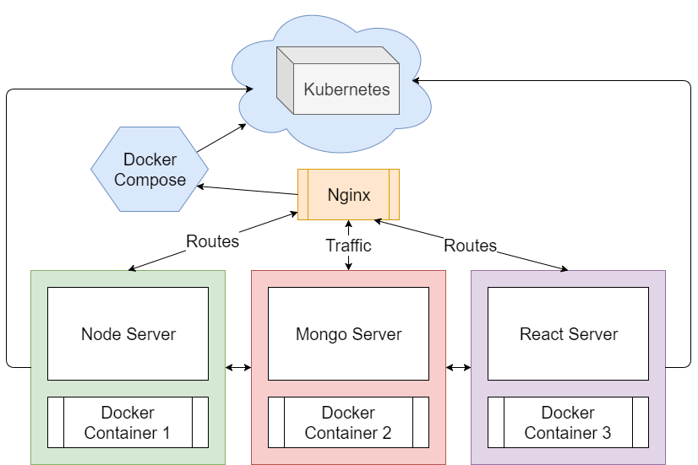
Older
Architecture

Slide 4
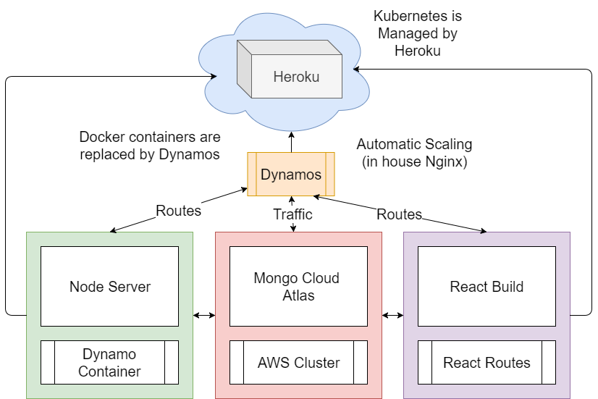
Newer
Architecture

Slide 5
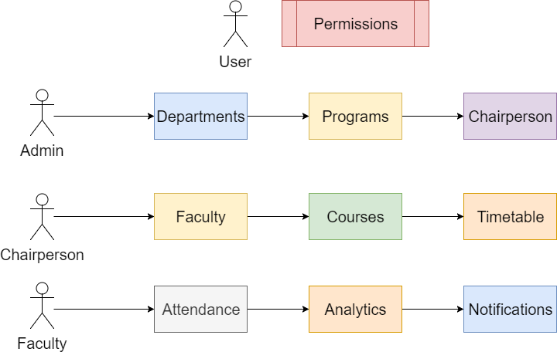
Review of
Use Cases

Slide 6
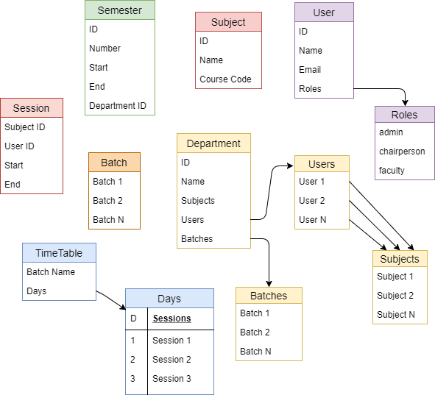
Database
Structure

Slide 7
What Has Been Done So Far
Routes setup for React, Redux and Node
Authentication using JSON Web Token
Backend with Frontend Setup for Development
Continuous Integration – Mocha, Coffee, Travis CI
Continuous Delivery – Github, Travis CI, Heroku

Slide 8
Demo

Slide 9
What Needs To Be Done
Working with Mobile Apps
API endpoint restructuring for Mobile Apps
Test cases for continuous integration
Backend with Frontend Setup for Production
Background jobs and scheduling

